Slide 1


Final project motivation video – predicting cyber attacks
This presentation systematically describes the main components and processes of our cybersecurity threat prediction project, ensuring clarity and a logical flow of information for technical stakeholders and product teams.
Notes:
Slide 1: Opening slide (title image with " CYBER WARFARE EXPOSED")
Introducing the participants.
Introducing the project topic: Predicting Cybersecurity Threats .
The importance of cybersecurity in the modern world.
Project goal: Developing a predictive approach to cyber threats.

Slide 2

Notes:
Video

Slide 3


Data integration
project relied on a carefully selected suite of data storage, management, and analytics platforms. This infrastructure was designed for flexibility, scalability, and collaborative efficiency, essential for handling diverse cybersecurity threat data.
1
2
3
MongoDB
MySQL
Google Sheets
MongoDB, known for its NoSQL capabilities , provides storage flexibility.
MySQL, used for structured data, managing large data sets and enabling complex queries and relationship management for analytical consistency.
Google Sheets, used for initial data capture and real-time collaboration.
4
5
OneDrive
Google Collaborate
Functioned as our primary cloud storage, providing secure data backup, granular version control, and seamless file synchronization between the team, critical for project continuity and data integrity.
Our cloud-based development environment, Colab , enabled efficient Python code execution , extensive data analysis, and scalable training of GPU-accelerated machine learning models .
Notes:
Slide 2: " CYBER SECURITY THREAT DETECTION"
Project goal: Identifying and predicting cyber threats .
The need for advanced information security solutions and why.
Briefly about each infrastructure where the data is stored
MongoDB - Flexible and scalable data storage.
MySQL - Structured data management and complex queries.
Google Sheets - Initial data capture and real-time collaboration.
OneDrive ]Secure cloud storage, data backup, and version control.

Slide 4




CHAPTER 2: VISUALIZATION & INTERACTIVITY
Dashboards
Visualizing cybersecurity threats and insights was critical for effective communication. We integrated different platforms to create dynamic, interactive dashboards and reports that turned complex data into actionable intelligence.
Tableau Public
Looker Studio
Funnel.io
Power BI
Used to create interactive dashboards , for dynamic visualization of cyber threats.
Used to produce advanced reports and dashboards with direct integration to our data sources, providing deep analytical capabilities and customizable data exploration.
Enabled a visual display of aggregated marketing and cybersecurity data from multiple disparate sources, centralizing insights into a holistic view of campaign performance and the threat landscape.
Used to create highly dynamic dashboards, enabling comprehensive performance measurement, strategic decision-making, and seamless organizational integration of threat intelligence.
Notes:
Briefly explain each of the dashboards and what they are used for in the project.
Tableau , Power BI , Google Data Studio , Funnel.io - Creating interactive dashboards , producing reports and advanced dashboards, dynamic dashboards for measuring performance .

Slide 5


CHAPTER 3: DEVELOPMENT & TECHNICAL CORE
Model deployment and programming
To deploy and demonstrate our predictive models, we used robust development and interactive application platforms. These tools ensured that our solutions were not only functional but also user-friendly and easily integrated into existing workflows.
Matplotlib, Seaborn, Yellowbrick
Used to create detailed graphs, charts, and visual representations of data, improving exploratory analysis and model interpretation.
Hugging Face (Gradio)
Essential in building intuitive web-based interfaces for our models, allowing users to effortlessly input data and receive real-time cybersecurity threat predictions.
ydata -profiling
Critical for generating automated and in-depth reports that included data
Statistics, missing value analysis and insights into our datasets,
Accelerate data understanding.
Flask Framework
A lightweight Python web framework used to embed our machine learning models directly into enterprise workflows, making predictive capabilities accessible and practical for end users through a simple API .
Notes:
Role tools Matplotlib, Seaborn, Yellowbrick - Creating graphs and charts.
Hugging Face ( Gradio ) Building intuitive interfaces for models.
ydata -profiling - Generating automatic reports on data.
Flask - Implementing models in organizational work processes.

Slide 6
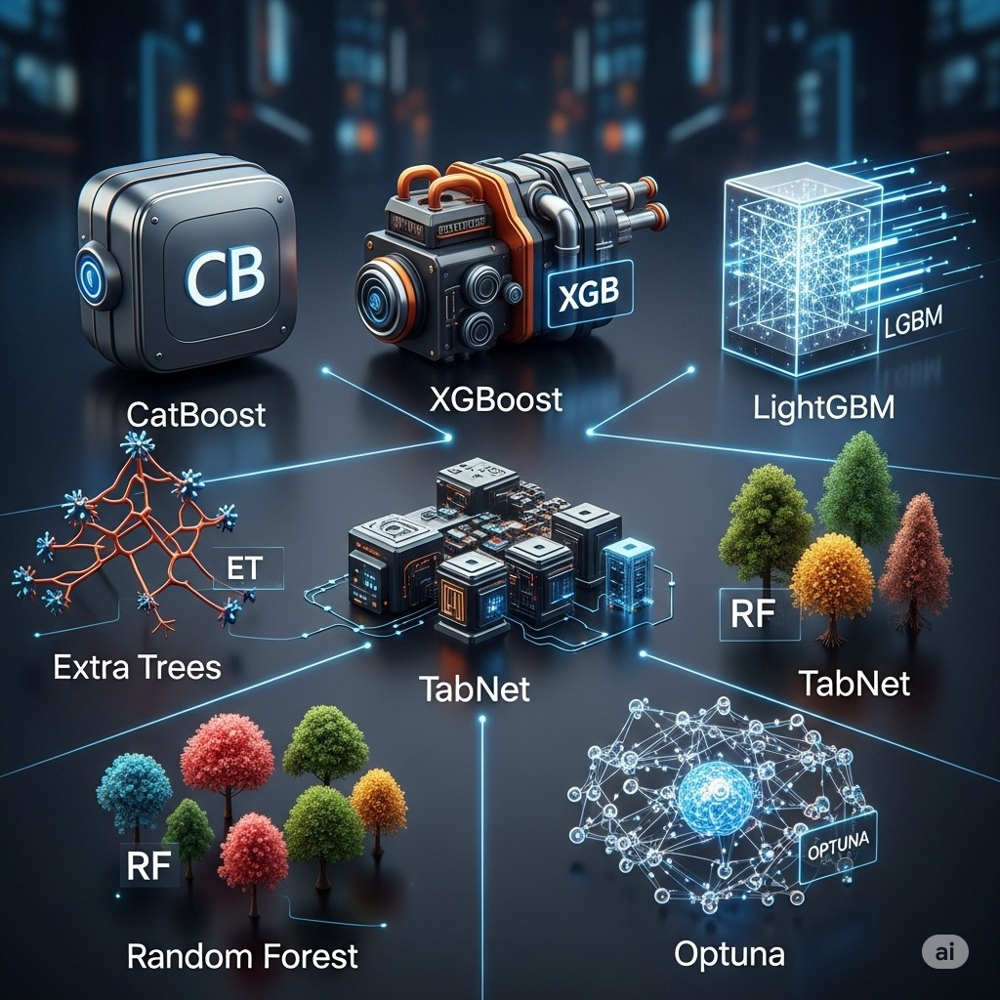
CHAPTER 4: ADVANCED ANALYTICS
Main models
Our cybersecurity threat prediction leveraged a diverse portfolio of advanced machine learning models, each selected for its unique strengths in handling complex data and ensuring high prediction accuracy. Parameter optimization was essential to optimize performance.
CatBoost
An ensemble learning method, specifically chosen for its original treatment of category features and resistance to overfitting, which provides high accuracy in predicting threat categories.
XGBoost & LightGBM
Gradient boosting frameworks known for their speed and performance with large datasets,
Providing highly accurate and effective threat prediction capabilities.
Extra Trees
An ensemble technique similar to random forest, offering improved generalization capabilities and reduced variance,
Which contributes to more stable and reliable forecasts.
TabNet
Modern neural network architecture adapted to tabular data, excels in interpretation ability
By identifying and optimizing key features that impact threat prediction.
Random Forest
A versatile ensemble model, efficient in handling multidimensional data and very powerful for classification and regression tasks, used for basic prediction and feature importance analysis.
Optuna
significantly improved automated hyperparameter optimization framework
The model performance by efficiently searching for optimal configurations across different algorithms.
Notes:
CatBoost : - Handling of categorical features and resistance to overfitting.
XGBoost & LightGBM : - Speed and performance with large datasets.
Extra Trees Classifier : - Improved generalization ability.
TabNet : - Identifying and refining key features.
Optuna : - Automatic optimization of hyperparameters .
CatBoost Model – Key Points –
Specializes in handling categorical features without the need for prior coding .
Resistant to overfitting
Innovative techniques:
Ordered Boosting – improves prediction accuracy .
Ordered Target Statistics – reduces noise in data.
Key advantages :
High prediction accuracy, even with complex data sets.
Resilience to problems such as missing values or unbalanced features.
Project use :
Chosen for its ability to provide accurate and reliable forecasts.
It is a key tool for predicting cyber threats.

Slide 7








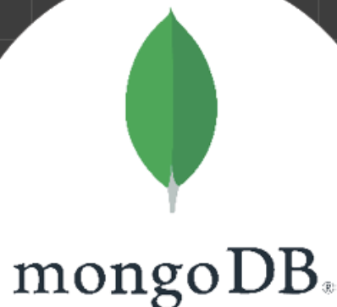



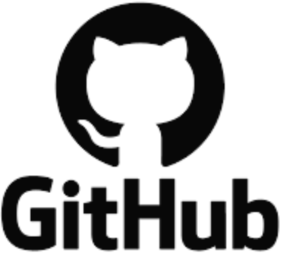
CHAPTER 4: ADVANCED ANALYTICS
Link

